Slide 1








Relational Model

Slide 2
Introduction to Relational Model
Relational Model is the theoretical basis of relational databases.
Relational Model of data is based on the concept of relations.
A “Relation” is a mathematical concept based on the ideas of sets
The Relational Model was proposed by E.F. Codd from IBM in 1970 to model data in the form of relations or tables.

Slide 3
What is Relational Model?
Relational Model represents how data is stored in Relational Databases. A relational database stores data in the form of relations(tables).
After designing the conceptual model of database using E-R diagram, we need to convert the conceptual model in the relational model which can be implemented using any RDBMS.
RDBMS : Oracle, SQL, MySQL etc.

Slide 4
What is RDBMS?
RDBMS stands for: Relational Database Management System. RDBMS is the basis for SQL, and for all modern database systems like MS SQL Server, IBM DB2, Oracle, MySQL and Microsoft Access.
An RDBMS is a database management system (DBMS) that is based on the relational model as introduced by E.F. Codd.
Current popular RDBMS include:
DB2 & Informix Dynamic Server – from IBM
Oracle & Rdb – from Oracle
SQL Server & MS Access – from Microsoft

Slide 5
Relational Model Concept
Relational model can be represented as a table with columns and rows.
Each row is known as a tuple.
Each table of the column has a name or attribute.
Roll No. | Name | Phone_No.
1 | Ajay | 9955668756
2 | Raj | 8874895645
3 | Vijay | 8874568925
4 | Aman | 9587456523

Slide 6
Basic concepts
Relation: A Relation is a table with columns and rows. Collection of homogeneous tuples.
Attribute: An attribute is a named column of a relation.
Domain: There are set of allowable values for every attribute, called its domain.
Exp- Domain of roll number{10,11,23,56,78}
Domain of branch{CSE,IT,ME,ECE}
Tuple: Each row in a relation is called tuple.
Relational Schema: A relational schema represents the name of the relation with is attributes.

Slide 7
Relation Instance: Relation instance is a finite set of tuples. Relation instances never have duplicate tuples.
Degree or Arity: Number of column or attributes in relation R.
Cardinality: Number of rows or tuples in relation R.
Relation Key: Every row has one or multiple attributes, that can uniquely identify the row in the relation, which is called relation(Primary Key).
Tuple Variable: It is the data stored in a record of the table.

Slide 8
Properties of Relational Model
Each relation has unique name.
Each row/tuple is unique. No duplicate row.
Entries in any column have the same domain.
Each attribute/column has a unique name.
Order of the column or rows is irrelevant i.e. relations are unordered.
Each cell of relation contains exactly one value i.e. attribute values are required to be atomic.

Slide 9
Alternative Terminology of Relational Model
Formal Terms | Alternative 1 | Alternative 2
Relation | Table | File
Tuple | Row | Record
Attribute | Column | Field

Slide 10
Integrity Constraints over Relation
Integrity Constraints are used to ensure accuracy and consistency of the data in a relational database.
Integrity constraints are set of rules that the database is not permitted to violate.
Constraints may apply to each attribute or they may apply to relationships between tables.
Integrity constraints ensure that changes made to the database by authorized users do not results in a loss of data consistency. Thus, integrity constraints guard against accidental damage to the database.
Example: A blood group must be ‘A or ‘B’ or ‘AB’ or ‘o’ only (Can not any other value else).

Slide 11
Types of Integrity Constraints
Domain Constraints
Entity Integrity Constraints
Referential Integrity Constraints
Key Constraints

Slide 12
Domain Constraints
Domain Constraints defines the domain or the valid set of values for an attribute.
The data type of domain includes string, character, integer, time, date, currency, etc. The value of the attribute must be available in the corresponding domain.
Student_ID | Name | Semester | Age
101 | Manish | 1st | 18
102 | Rohit | 3rd | 19
103 | Amrit | 7th | 20
104 | Aman | 5th | A

Slide 13
Entity Integrity Constraints
The entity integrity constraint states that primary key value can’t be null.
This is because the primary key value is used to identified individual rows in relation and if the primary key has a null value, then we can’t identify those rows.
A table can contain a null value other than the primary key field.
Emp_ID | Emp_Name | Salary
111 | Mohan | 20000
112 | Rohan | 30000
113 | Sohan | 35000
 | Om | 20000

Slide 14
Referential Integrity Constraints
A referential integrity constraint is specified between two tables.
It is enforced when a foreign key references the primary key of a table.
In the Referential integrity constraints, if a foreign key in Table 1 refers to the primary key of table 2, then either every value of the foreign key in table 1 must be available in primary key value of table 2 or it must be null.
The rules are:
You cannot delete a record from a primary table if matching records exist in a related table.
You cannot change a primary key value in the primary table if that record has related records.
You cannot insert a value in the foreign key field of the related table that does not exist In the primary key of the primary table.
However, you can enter a Null value in the foreign key, specifying that the records are unrelated.

Slide 15
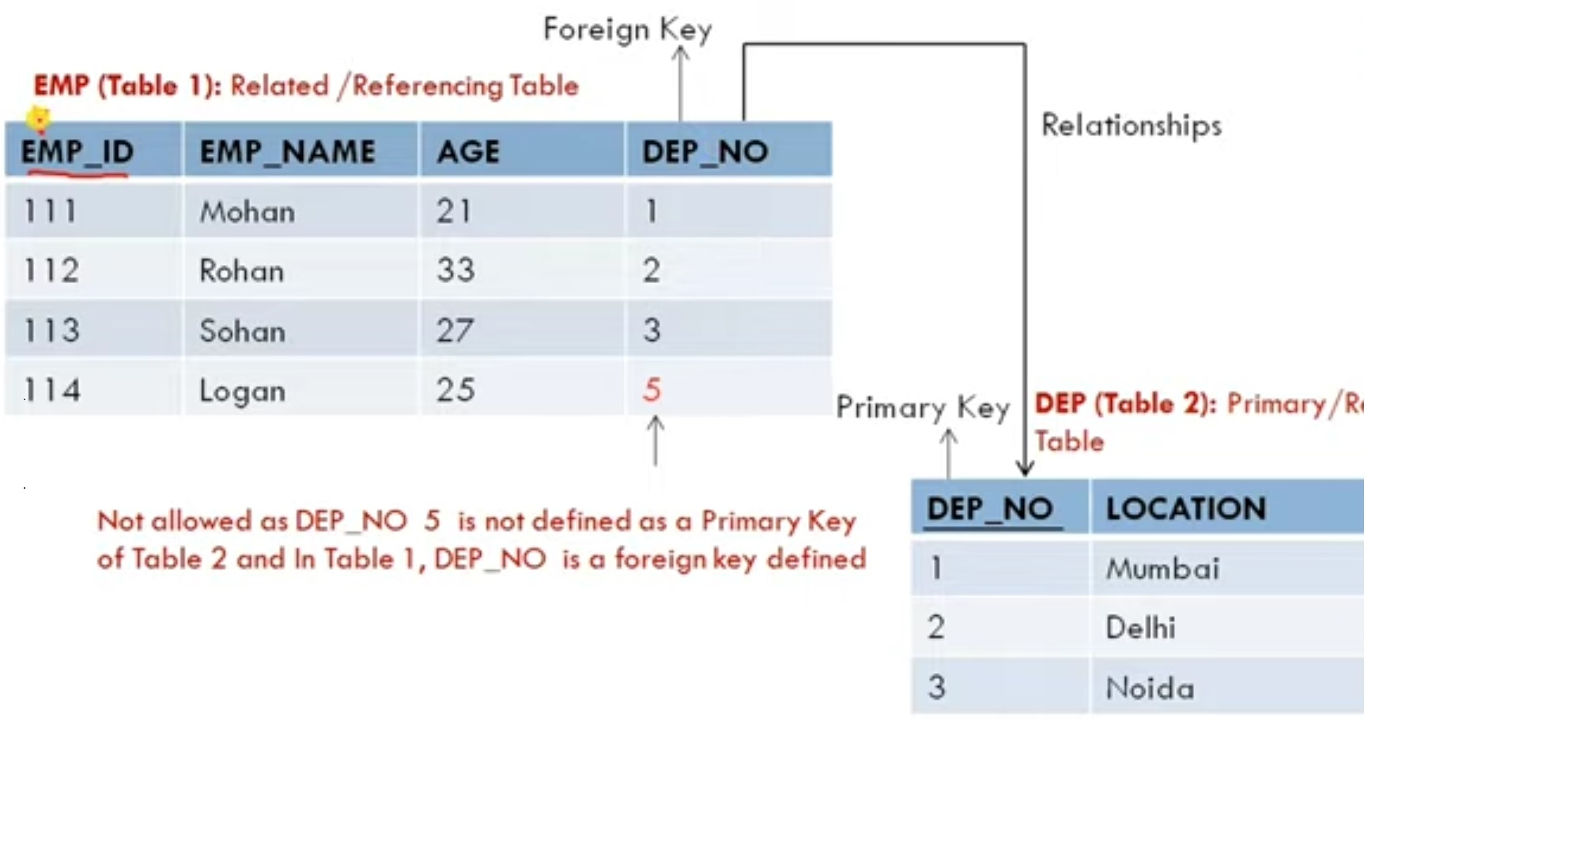
Notes:
The child-parents relationship between tables. Primary key of parent table will be foreign key of child table and it must not be NULL.

Slide 16
Key Constraints
An entity set can have multiple keys or candidate keys(minimal super key), but out of which one key will be the primary key.
Key constraints specifies that in any relation-
All the values of primary key must be unique.
The value of primary key must not be Null.
Student_ID | Name | Semester | Age
101 | Manish | 1st | 18
102 | Rohit | 3rd | 19
103 | Parkash | 5th | 20
102 | Amrit | 7th | 21

Slide 17
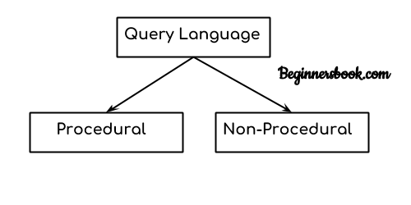
Query Language
Interface between the user and the data base.
A query is a statement written in query language for retrieval of data from database. Eg. SQL
Query= “Retrieval Program”

Slide 18
Procedural vs. Non- Procedural
Procedural query language
In procedural query language user instructs the system to perform a series of operations to produce the desired results.
Here users tells what data to be retrieved from database and how to retrieve it.
Non-Procedural query language
In Non-procedural query language, user instructs the system to produce the desired result without telling the step by step process.
Here users tells what data to be retrieved from database but doesn’t tell how to retrieve it.

Slide 19
Two “Pure” Query Language
Two “Pure” Query Language or Two Mathematical Query Language:
Relational Algebra
Relational Calculus
Tuple Relational Calculus
Domain Relational Calculus

Slide 20
Relational Algebra:
Relational algebra is a conceptual procedural query language.
It is more operational, very useful for representing execution plans.
Procedural: What data is required and how to get those data.
Relational Calculus:
Relational calculus is a conceptual non-procedural query language.
It is non-operational or declarative.
Non-Procedural: What data they want without specifying how to get those data.

Slide 21
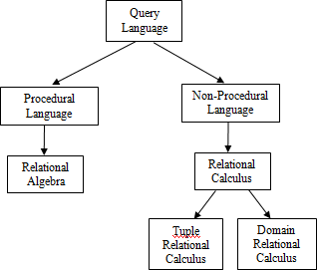

Slide 22
Relational Algebra
Procedural Language(formal Query language)
It is the base of SQL. It is used to make SQL.
Relational Algebra is a system used to model data stored in relational databases.
It’s largely used as the theoretical basis for which query languages like SQL are built around.
It is a language to express relational queries.

Slide 23
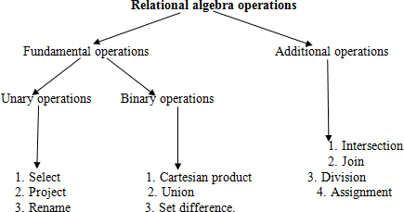
INTRODUCTION

Slide 24
Select
Select
Select operation selects the rows that satisfy a given predicate (condition).
The Greek letter sigma is used to denote the select operation.
Syntax:

Slide 25
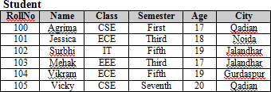
Find the students from the student relation who belong to qadian CITY.

Slide 26
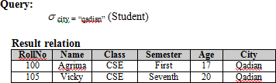

Slide 27
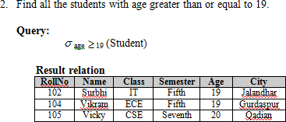

Slide 28
BRANCH_NAME | LOAN_NO | AMOUNT
Downtown | L-17 | 1000
Redwood | L-23 | 2000
Perryride | L-15 | 1500
Downtown | L-14 | 1500
Mianus | L-13 | 500
Roundhill | L-11 | 900
Perryride | L-16 | 1300
σ BRANCH_NAME="perryride" (LOAN)

Slide 29
BRANCH_NAME | LOAN_NO | AMOUNT
Perryride | L-15 | 1500
Perryride | L-16 | 1300

Slide 30
Project
Use to select attributes from the relation

Slide 31
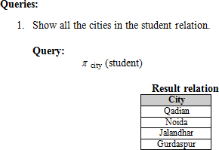

Slide 32
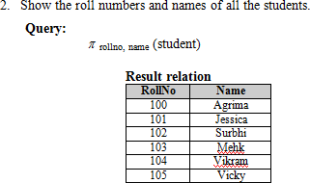

Slide 33
NAME | STREET | CITY
Jones | Main | Harrison
Smith | North | Rye
Hays | Main | Harrison
Curry | North | Rye
Johnson | Alma | Brooklyn
Brooks | Senator | Brooklyn
∏ NAME, CITY (CUSTOMER)

Slide 34
NAME | CITY
Jones | Harrison
Smith | Rye
Hays | Harrison
Curry | Rye
Johnson | Brooklyn
Brooks | Brooklyn

Slide 35
Rename
Used for following
1. When we want to change the name of any existing relation
2. When we want to give a name to a new relation which is obtained as a result of any relational algebra expression
ρ _{(new relaion)} (Relation)

Slide 36
Query to rename the first attribute of the table Student with attributes A, B, C to P.
ρ _{(P, B, C)} (Student)
Query to rename the table name Project to Pro and its attributes to P, Q, R.
ρ _{Pro(P, Q, R)} (Project)

Slide 37
Query to rename the attributes Name, Age of table Department to A,B.
ρ _{(A, B)} (Department)
Query to rename the table name Loan to L.
ρ _{L} (LOAN)

Slide 38
Cartesian Product
Cartesian product is denoted by cross (×) and it combines the information from any two relations.
Cartesian product of two relations R and S is denoted as R×S, which result in a new relation that contains all the possible combinations of tuples in R and S.

Slide 39
Degree or arity (P) = arity(R) + arity(S)
Cardinality (P) = cardinality(R) * cardinality(S)

Slide 40
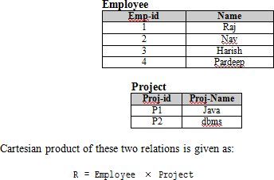

Slide 41
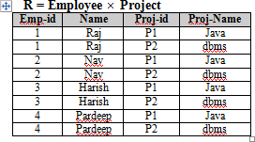

Slide 42
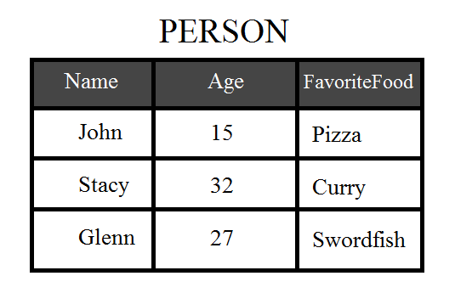
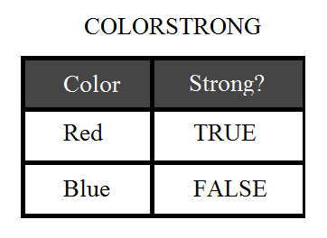

Slide 43
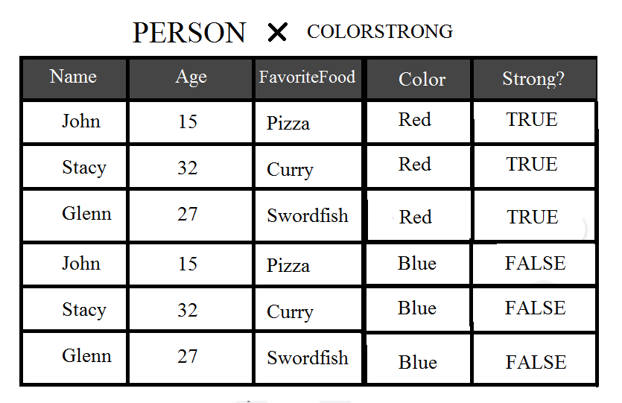

Slide 44

Union
the union of two sets results in a new set that contains all the elements belonging to both the sets but does not include the duplicate elements

Slide 45
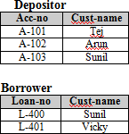

Slide 46
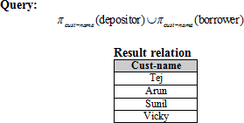

Slide 47
Regno | Branch | Section
1 | CSE | A
2 | ECE | B
3 | MECH | B
4 | CIVIL | A
5 | CSE | B
Regno | Branch | Section
1 | CIVIL | A
2 | CSE | A
3 | ECE | B
To display all the regno of R1 and R2, use the following command −
∏regno(R1) ∪ ∏regno(R2)

Slide 48
Regno
1
2
3
4
5
To retriev

Slide 49

Set Difference
the difference of two sets results in a new set that contains all the elements of first set which are not present in the second set.

Slide 50
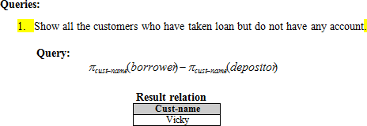

Slide 51
Example PERSON relation with attributes Name, Age, and FavoriteFood

Slide 52
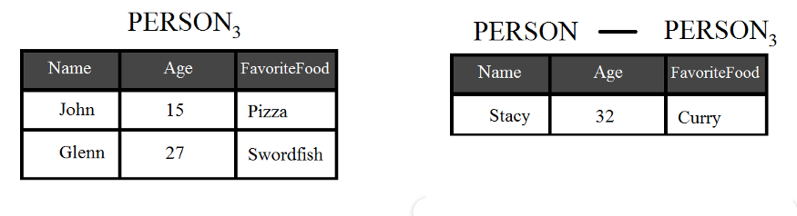
If we have another table, Person3, we can take the difference of the Person relation to Person3, to result in a single row table with Stacy.

Slide 53

Intersection
Intersection of two sets results in a new set which contains the common elements from both the sets.

Slide 54
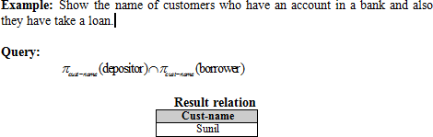

Slide 55
Natural Join
Join operation allows us to combine certain selections and cartesian product into one operation.

Slide 56

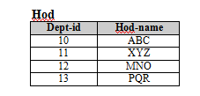


Slide 57

Example: Show all the customers who have an account and also have taken a loan.

Slide 58



Slide 59
Outer Join
Outer-join operation is an extension of natural join which deals with missing information.

Slide 60
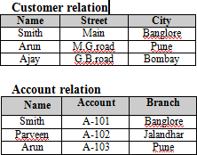

Slide 61


Slide 62


Slide 63
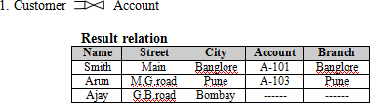

Slide 64
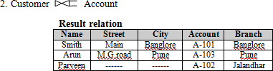

Slide 65
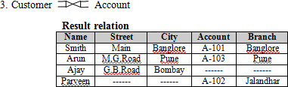

Slide 66
Division Operator (÷ or /)
Division operator is a Derived Operator, not supported as a primitive operator.
Suited to queries that include the keyword “all” or “every” like “at all” , “for all” or “in all”, “at every”, “for every” or “in every”. Eg:
Find the person that has account in all the banks of a particular city.
Find sailors who have reserved all boats.
Find employees who works on all project of company.
Find student who have registered for every course
In all these queries, the description after the keyword “all” or “every” defines a set which contains some elements and the result contains those records who satisfy these requirements.
Notation: A÷B or A/B

Slide 67
Division Operator (÷ or /)
Division Operator can be applied if and only if :
Attributes of B is proper subset of Attributes of A.
The relation returned by division operator will have attributes =(All attributes of A – All attributes of B).
The relation returned by division operator will return those tuple from relation A which are associated to every B’s tuple.
A
B
x | y
a | 1
b | 2
a | 2
d | 4
y
1
2
x
a

Slide 68
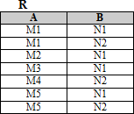


Slide 69


Slide 70
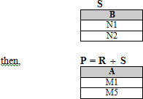

Slide 71
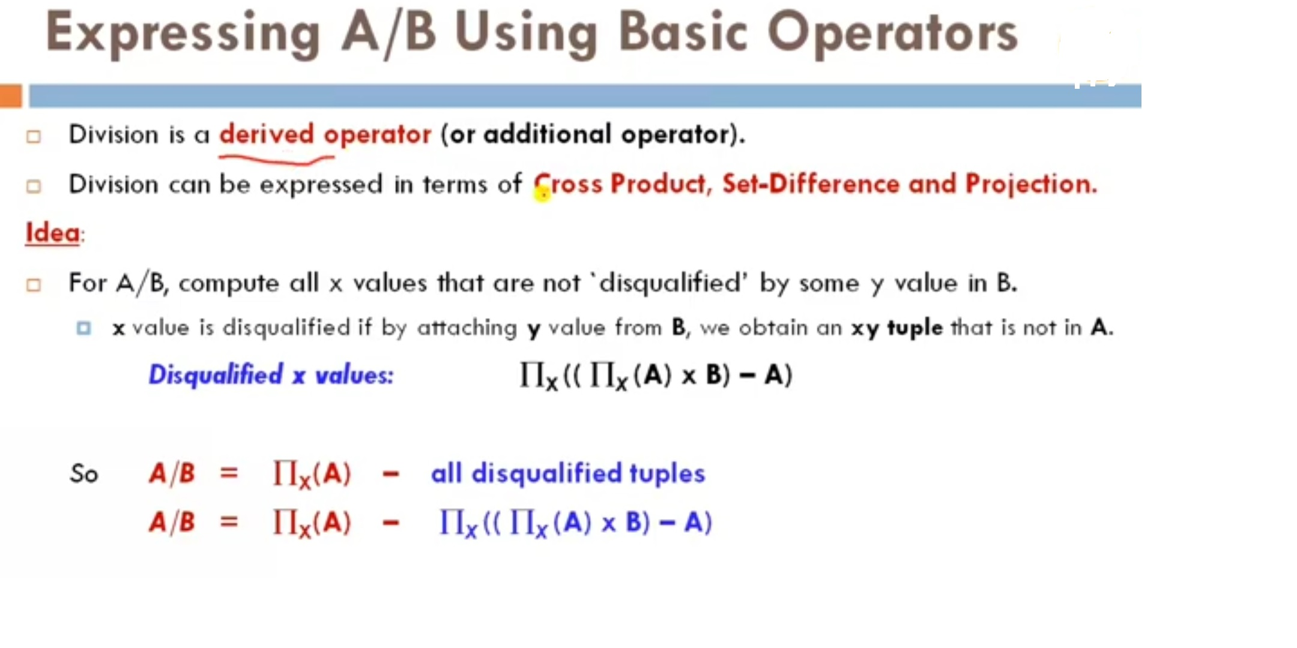

Slide 72
Find the Sid of that students who enrolled in every courses
Enrolled
Course
Sid | Cid
S1 | C1
S2 | C2
S1 | C2
S3 | C2
Cid
C1
C2

Slide 73
A
Sno | Pno
S1 | P1
S1 | P2
S1 | P3
S1 | P4
S2 | P1
S2 | P2
S3 | P2
S4 | P2
S4 | P4
B1
B2
B3
Pno
P2
Pno
P2
P4
Pno
P1
P2
P4

Slide 74
A/B1
A/B2
A/B3
Sno
S1
S2
S3
s4
Sno
S1
S4
Sno
S1

Slide 75
Assignment Operator ( )
The assignment operator provides a convenient way to express complex queries.
It writes query as a sequential program consisting of:
A series of assignments
Followed by an expression whose value is displayed as a result of the query.
Assignment must always be made to a temporary relation variable.

Slide 76
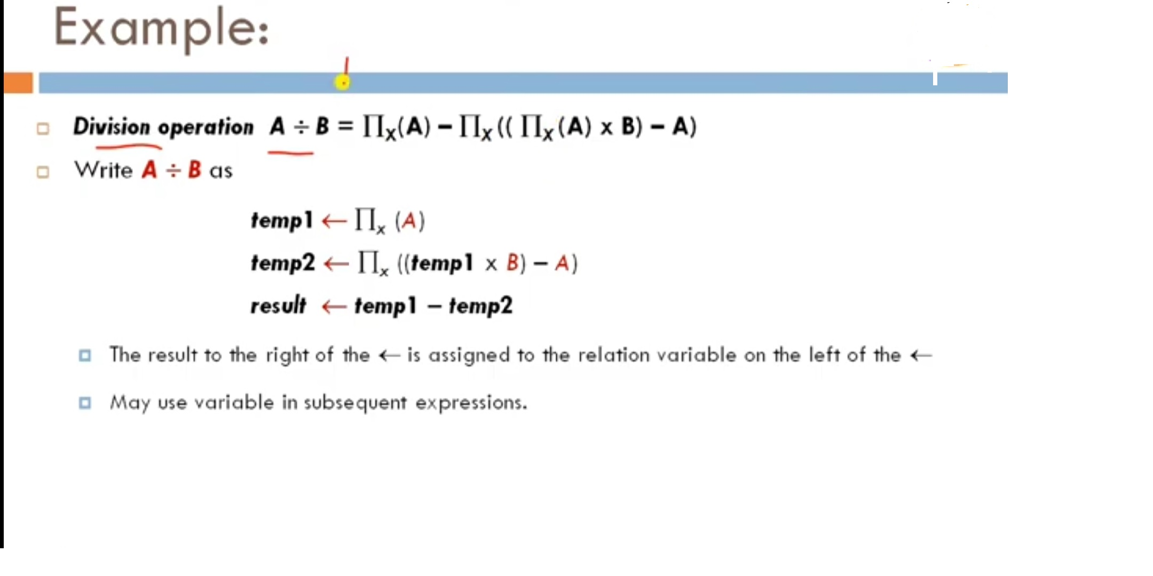

Slide 77
